Slide 1
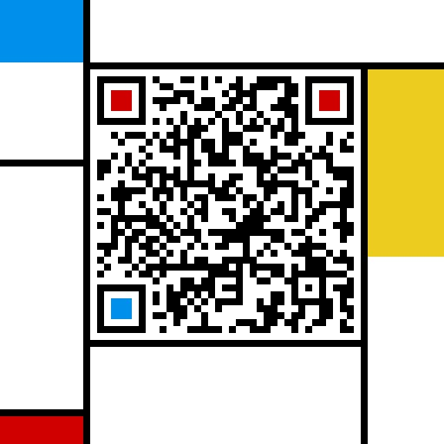
计算机组成与系统结构 Computer Organization & System Architecture
Huang Kejie (黄科杰) 百人计划研究员
Office: 玉泉校区老生仪楼304
Email address: huangkejie@zju.edu.cn
HP: 17706443800

Slide 2
Components of a Computer
Processor
Memory
Input
Enable?
Read/Write
Control
Program
Datapath
Address
Bytes
PC
Registers
Write Data
Data
Arithmetic & Logic Unit
(ALU)
ReadData
Output
Processor-Memory Interface
I/O-Memory Interfaces

Slide 3
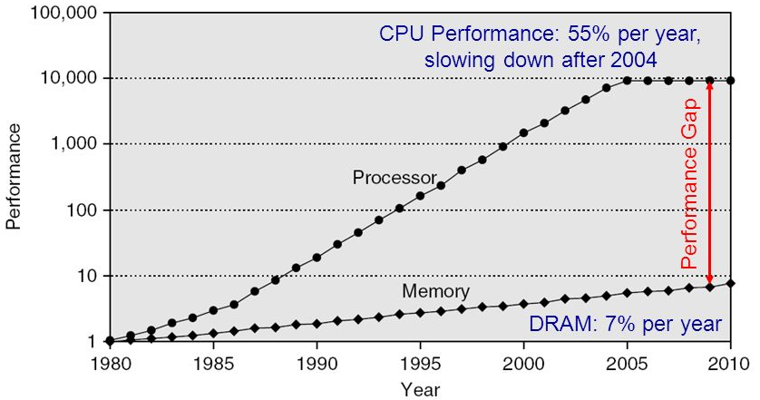
Processor-DRAM Gap (Latency)
1980 microprocessor executes ~one instruction in same time as DRAM access
2017 microprocessor executes ~1000 instructions in same time as DRAM access
Slow DRAM access has disastrous impact on CPU performance!

Slide 4
Typical Memory Hierarchy
On-Chip Components
Control
Third-Level
Cache
(SRAM)
Instr
Cache
Second-Level
Cache
(SRAM)
Main
Memory
(DRAM)
Secondary
Memory
(Disk
Or Flash)
Datapath
RegFile
Data
Cache
Speed (cycles): ½’s 1’s 10’s 100’s-1000 1,000,000’s
Size (bytes): 100’s 10K’s M’s G’s T’s
Cost/bit: highest lowest
Principle of locality + memory hierarchy presents programmer with ≈ as much memory as is available in the cheapest technology at the ≈ speed offered by the fastest technology

Slide 5
Big Idea: Locality
Temporal Locality (locality in time)
Go back to same book on desk multiple times
If a memory location is referenced, then it will tend to be referenced again soon
Spatial Locality (locality in space)
When go to book shelf, pick up multiple books on J.D. Salinger since library stores related books together
If a memory location is referenced, the locations with nearby addresses will tend to be referenced soon

Slide 6
Adding Cache to Computer
Processor
Memory
Input
Enable?
Read/Write
Control
Program
Memory (including
cache) organized around blocks, which are typically multiple words
Datapath
Address
Bytes
PC
Cache
Registers
Write Data
Data
Arithmetic & Logic Unit
(ALU)
Read Data
Output
Processor organized around words and bytes
Processor-Memory Interface
I/O-Memory Interfaces

Slide 7
Pipelined RISC-V RV32I Datapath (with I,D$)
Recalculate PC+4 in M stage to avoid sending both PC and PC+4 down pipeline
Must pipeline instruction along with data, so control operates correctly in each stage

Slide 8
CPU-Cache Interaction (5-stage pipeline)
0x4
Add
E
Decode,
Register
Fetch
M
A
we
Y
addr
bubble
ALU
Y
IR
B
Primary
Data
Cache
rdata
PC
addr
inst
D
R
hit?
wdata
hit?
wdata
Primary
Instruction
Cache
MD1
MD2
Stall entire CPU on data cache miss
To Memory Control
Cache Refill Data from Lower Levels of Memory Hierarchy

Slide 9
Inside a Cache
Address
Address
Processor
CACHE
Main
Memory
Data
Data
copy of main
memory
location 100
copy of main
memory
location 101
100
Data
Byte
Data
Byte
Line
304
Data
Byte
Address
Tag
6848
416
Data Block

Slide 10
Cache Terminology
hit: data appears in some block
hit rate: the fraction of accesses found in the level
hit time: time to access the level (consists of RAM access time + time to determine hit)
miss: data needs to be retrieved from a block in the lower level (e.g., block Y)
miss rate = 1 - (hit rate)
miss penalty: time to replace a block in the upper level + time to deliver the block to the processor
hit time << miss penalty
Abbreviation: “$” = cache (a Berkeley innovation!)

Slide 11
Average Memory Access Time (AMAT)
Average Memory Access Time (AMAT) is the average time to access memory considering both hits and misses in the cache
AMAT = Time for a hit + Miss rate × Miss penalty
miss penalty: time to fetch a block from lower memory level
access time: function of latency
transfer time: function of bandwidth b/w levels
transfer one “cache line/block” at a time
transfer at the size of the memory-bus width
Important Equation!

Slide 12
Peer Instruction
AMAT = Time for a hit + Miss rate × Miss penalty
Given a 200 psec clock, a miss penalty of 50 clock cycles, a miss rate of 0.02 misses per instruction and a cache hit time of 1 clock cycle, what is AMAT?
A : ≤200 psec
B : 400 psec
C : 600 psec
D : ≥ 800 psec

Slide 13
Processor Address Fields Used by Cache Controller
Block Offset: Byte address within block
Set Index: Selects which set
Tag: Remaining portion of processor address
Size of Index = log₂(number of sets)
Size of Tag = Address size – Size of Index – log₂(number of bytes/block)
Processor Address (32-bits total)
Tag
Set Index
Block offset

Slide 14
What Limits Number of Sets?
For a given total number of blocks, we save comparators if have more than two sets
Limit: As Many Sets as Cache Blocks => only one block per set – only needs one comparator!
Called “Direct-Mapped” Design
Tag
Index
Block offset

Slide 15
Direct-Mapped Cache
Tag
Index
Block
Offset
t
k
b
V
Tag
Data Block
2^{k}
lines
t
=
HIT
Data Word or Byte

Slide 16
Direct Mapped Cache Example: Mapping a 6-bit Memory Address
5
4
3
2
1
0
Tag
Index
Byte Offset
Mem Block Within $ Block
Block Within $
Byte Within Block
In example, block size is 4 bytes/1 word
Memory and cache blocks always the same size, unit of transfer between memory and cache
# Memory blocks >> # Cache blocks
16 Memory blocks = 16 words = 64 bytes => 6 bits to address all bytes
4 Cache blocks, 4 bytes (1 word) per block
4 Memory blocks map to each cache block
Memory block to cache block, aka index: middle two bits
Which memory block is in a given cache block, aka tag: top two bits

Slide 17
One More Detail: Valid Bit
When start a new program, cache does not have valid information for this program
Need an indicator whether this tag entry is valid for this program
Add a “valid bit” to the cache tag entry
0 => cache miss, even if by chance, address = tag
1 => cache hit, if processor address = tag

Slide 18
Cache Organization: Simple First Example
Main Memory
0000xx
0001xx
0010xx
0011xx
0100xx
0101xx
0110xx
0111xx
1000xx
1001xx
1010xx
1011xx
1100xx
1101xx
1110xx
1111xx
One word blocks
Two low order bits (xx) define the byte in the block (32b words)
Cache
Index
Valid
Tag
Data
00
01
10
11
Q: Where in the cache is the mem block?
Use next 2 low-order memory address bits – the index – to determine which cache block (i.e., modulo the number of blocks in the cache)
Q: Is the memory block in cache?
Compare the cache tag to the high-order 2 memory address bits to tell if the memory block is in the cache (provided valid bit is set)

Slide 19
Direct-Mapped Cache Example
One word blocks, cache size = 1K words (or 4KB)
Byte offset
31 30 . . . 13 12 11 . . . 2 1 0
Hit
Tag
20
10
Data
Valid bit ensures something useful in cache for this index
Index
Read data from cache instead of memory if a Hit
Index
Valid
Tag
Data
0
1
2
.
.
.
1021
1022
1023
Compare Tag with upper part of Address to see if a Hit
20
32
Comparator
What kind of locality are we taking advantage of?

Slide 20
Multiword-Block Direct-Mapped Cache
Four words/block, cache size = 1K words
Hit
31 30 . . . 13 12 11. . . 4 . . . 0
Byte offset
Data
Tag
20
8
2
Word offset
Index
Index
Valid
Tag
Data
0
1
2
.
.
.
253
254
255
20
32
What kind of locality are we taking advantage of?

Slide 21
Ping Pong Cache Example: Direct-Mapped Cache w/4 Single-Word Blocks, Worst-Case Reference String
Consider the main memory address reference string of word numbers:
0 4 0 4 0 4 0 4
Start with an empty cache - all blocks initially marked as not valid
0
4
0
4
0
4
0
4

Slide 22
Ping Pong Cache Example: Direct-Mapped Cache w/4 Single-Word Blocks, Worst-Case Reference String
Consider the main memory address reference string of word numbers:
0 4 0 4 0 4 0 4
Start with an empty cache - all blocks initially marked as not valid
0
miss
01
4
miss
4
00
0
miss
0
01
4
miss
4
00 Mem(0)
00 Mem(0)
01 Mem(4)
00 Mem(0)
0
miss
01
4
miss
0
miss
4
miss
00
0
4
00
0
01
4
01 Mem(4)
00 Mem(0)
01 Mem(4)
00 Mem(0)
8 requests, 8 misses
Ping-pong effect due to conflict misses - two memory locations that map into the same cache block

Slide 23
Example: 2-Way Set Associative $ (4 words = 2 sets x 2 ways per set)
Main Memory
0000xx
0001xx
0010xx
0011xx
0100xx
0101xx
0110xx
0111xx
1000xx
1001xx
1010xx
1011xx
1100xx
1101xx
1110xx
1111xx
Cache
One word blocks
Two low order bits define the byte in the word (32b words)
Way
Set
V
Tag
Data
0
0
1
1
0
1
Q: How do we find it?
Use next 1 low order memory address bit to determine which cache set (i.e., modulo the number of sets in the cache)
Q: Is it there?
Compare all the cache tags in the set to the high order 3 memory address bits to tell if the memory block is in the cache

Slide 24
2-Way Set-Associative Cache
Tag
Index
Block
Offset
b
t
k
V
Tag
Data Block
V
Tag
Data Block
t
=
=
Data
Word
or Byte
HIT

Slide 25
Ping Pong Cache Example: 4 Word 2-Way SA $, Same Reference String
Consider the main memory word reference string
0 4 0 4 0 4 0 4
Start with an empty cache - all blocks initially marked as not valid
0
miss
4
miss
0
hit
4
hit
000 Mem(0)
000 Mem(0)
000 Mem(0)
000 Mem(0)
010 Mem(4)
010 Mem(4)
010 Mem(4)
8 requests, 2 misses
Solves the ping-pong effect in a direct-mapped cache due to conflict misses since now two memory locations that map into the same cache set can co-exist!

Slide 26
Four-Way Set-Associative Cache
2⁸ = 256 sets each with four ways (each with one block)
31 30 . . . 13 12 11 . . . 2 1 0
Byte offset
Tag
22
8
Index
Index
0
1
2
...
253
254
255
V
Tag
Data
0
1
2
...
253
254
255
V
Tag
Data
0
1
2
...
253
254
255
V
Tag
Data
0
1
2
...
253
254
255
V
Tag
Data
Way 0
Way 1
Way 2
Way 3
32
4x1 select
Hit
Data

Slide 27
Alternative Cache Organizations
“Fully Associative”: Block can go anywhere
First design in lecture
Note: No Index field, but one comparator/block
“Direct Mapped”: Block goes one place
Note: Only 1 comparator
Number of sets = number blocks
“N-way Set Associative”: N places for a block
Number of sets = number of blocks / N
N comparators
Fully Associative: N = number of blocks
Direct Mapped: N = 1

Slide 28
Types of Caches
type of cache | mapping of data from memory to cache | complexity of searching the cache
Direct mapped (DM) | a memory value can be placed at a single corresponding location in the cache | fast indexing mechanism
set- associative (SA) | a memory value can be placed in any of a set of locations in the cache | slightly more involved search mechanism
fully- associative (FA) | a memory value can be placed in any location in the cache | extensive hardware resources required to search (CAM)

Slide 29
Describing Caches: 7 Parameters
access time: T_{hit}
capacity
total amount of data the cache can hold
# of blocks × block size
block (line) size
the amount of data that gets moved into or out of the cache as a chunk
analogous to page size in virtual memory
replacement policy
what data is replaced on a miss?
associativity
how many locations in the cache is a given address eligible to be placed in?
unified, instruction, data
what type of data is kept in the cache? We’ll cover this in more detail later

Slide 30
Range of Set-Associative Caches
For a fixed-size cache and fixed block size, each increase by a factor of two in associativity doubles the number of blocks per set (i.e., the number of ways) and halves the number of sets
decreases the size of the index by 1 bit and increases the size of the tag by 1 bit
More Associativity (more ways)
Used for tag compare
Selects the set
Selects the word in the block
Tag
Index
Word offset
Byte offset
Decreasing associativity, lower way, more sets
Increasing associativity, higher way, less sets
Fully associative
(only one set)
Tag is all the bits except
block and byte offset
Direct mapped
(only one way)
Smaller tags, only a single comparator

Slide 31
Example: Alternatives in an 8 Block Cache
Direct Mapped: 8 blocks, 1 way, 1 tag comparator, 8 sets
Fully Associative: 8 blocks, 8 ways, 8 tag comparators, 1 set
2 Way Set Associative: 8 blocks, 2 ways, 2 tag comparators, 4 sets
4 Way Set Associative: 8 blocks, 4 ways, 4 tag comparators, 2 sets
DM:
8 sets
1 way
0
FA:
1 set
8 ways
0
2 Way SA: 4 sets
0
4 Way SA: 2 sets
0
1
1
1
Set 0
1
2
Set 0
2
2
2
Set 1
3
3
3
3
4
4
4
4
5
5
5
Set 2
5
6
Set 1
6
6
6
Set 3
7
7
7
7

Slide 32
Peer Instruction
For a cache with constant total capacity, if we increase the number of ways by a factor of two, which statement is false:
A : The number of sets could be doubled
B : The tag width could decrease
C : The block size could stay the same
D : The block size could be halved

Slide 33
Example of Caches
given a 2MB, direct-mapped physical caches, line size=64bytes, and 52-bit physical address
tag size?
now change it to 16-way, tag size?
how about if it’s fully associative, tag size?

Slide 34
Total Cache Capacity =
Associativity * # of sets * block_size
Bytes = blocks/set * sets * Bytes/block
C = N * S * B
Tag
Index
Byte Offset
address_size = tag_size + index_size + offset_size
= tag_size + log₂(S) + log₂(B)
Double the Associativity: Number of sets?
tag_size? index_size? # comparators?
Double the Sets: Associativity?
tag_size? index_size? # comparators?

Slide 35
Block Size and Spatial Locality
Block is unit of transfer between the cache and memory
4 word block, b=2
Tag
Word0
Word1
Word2
Word3
Split CPU address
block address offset_{b}
32-b bits
b bits
2^{b} = block size a.k.a line size (in bytes)
Larger block size has distinct hardware advantages
less tag overhead
exploit fast burst transfers from DRAM
exploit fast burst transfers over wide busses
What are the disadvantages of increasing block size?
Fewer blocks => more conflicts. Can waste bandwidth.

Slide 36
Fully Associative Cache
V
Tag
Data Block
t
=
Tag
t
=
HIT
Block
Offset
Data
Word
or Byte
=
b

Slide 37
Your Turn
For a cache of 64 blocks, each block four bytes in size:
The capacity of the cache is: ____ bytes.
Given a 2-way Set Associative organization, there are ___ sets, each of __ blocks, and __ places a block from memory could be placed.
Given a 4-way Set Associative organization, there are ____ sets each of __ blocks and __ places a block from memory could be placed.
Given an 8-way Set Associative organization, there are ____ sets each of __ blocks and ___ places a block from memory could be placed.

Slide 38
Peer Instruction
For a cache with constant total capacity, if we increase the number of ways by a factor of two, which statement is false:
A : The number of sets is halved
B : The tag width decreases
C : The block size stays the same
D : The set index decreases

Slide 39
Peer Instruction
For S sets, N ways, B blocks, which statements hold?
The cache has B tags
The cache needs N comparators
B = N x S
Size of Index = Log₂(S)
A : (i) only
B : (i) and (ii) only
C : (i), (ii), (iii) only
D : All four statements are true

Slide 40
Costs of Set-Associative Caches
N-way set-associative cache costs
N comparators (delay and area)
MUX delay (set selection) before data is available
Data available after set selection (and Hit/Miss decision). DM $: block is available before the Hit/Miss decision
In Set-Associative, not possible to just assume a hit and continue and recover later if it was a miss
When miss occurs, which way’s block selected for replacement?
Least Recently Used (LRU): one that has been unused the longest (principle of temporal locality)
Must track when each way’s block was used relative to other blocks in the set
For 2-way SA $, one bit per set → set to 1 when a block is referenced; reset the other way’s bit (i.e., “last used”)

Slide 41
Cache Replacement Policies
Random Replacement
Hardware randomly selects a cache evict
Least-Recently Used
Hardware keeps track of access history
Replace the entry that has not been used for the longest time
For 2-way set-associative cache, need one bit for LRU replacement
Example of a Simple “Pseudo” LRU Implementation
Assume 64 Fully Associative entries
Hardware replacement pointer points to one cache entry
Whenever access is made to the entry the pointer points to:
Move the pointer to the next entry
Otherwise: do not move the pointer
(example of “not-most-recently used” replacement policy)
Entry 0
Replacement
Entry 1
Pointer
:
Entry 63

Slide 42
Replacement Policy
In an associative cache, which block from a set should be evicted when the set becomes full?
Random
Least-Recently Used (LRU)
LRU cache state must be updated on every access
true implementation only feasible for small sets (2-way)
pseudo-LRU binary tree often used for 4-8 way
First-In, First-Out (FIFO) a.k.a. Round-Robin
used in highly associative caches
Not-Most-Recently Used (NMRU)
FIFO with exception for most-recently used block or blocks
This is a second-order effect. Why?
Replacement only happens on misses

Slide 43
Placement Policy
Block Number
1 1 1 1 1 1 1 1 1 1 0 1 2 3 4 5 6 7 8 9
2 2 2 2 2 2 2 2 2 2 0 1 2 3 4 5 6 7 8 9
3 3
0 1
0 1 2 3 4 5 6 7 8 9
Memory
Set Number
0 1 2 3
0 1 2 3 4 5 6 7
Cache
Fully (2-way) Set Direct
Associative Associative Mapped
anywhere anywhere in only into
set 0 block 4
(12 mod 4) (12 mod 8)
block 12
can be placed

Slide 44
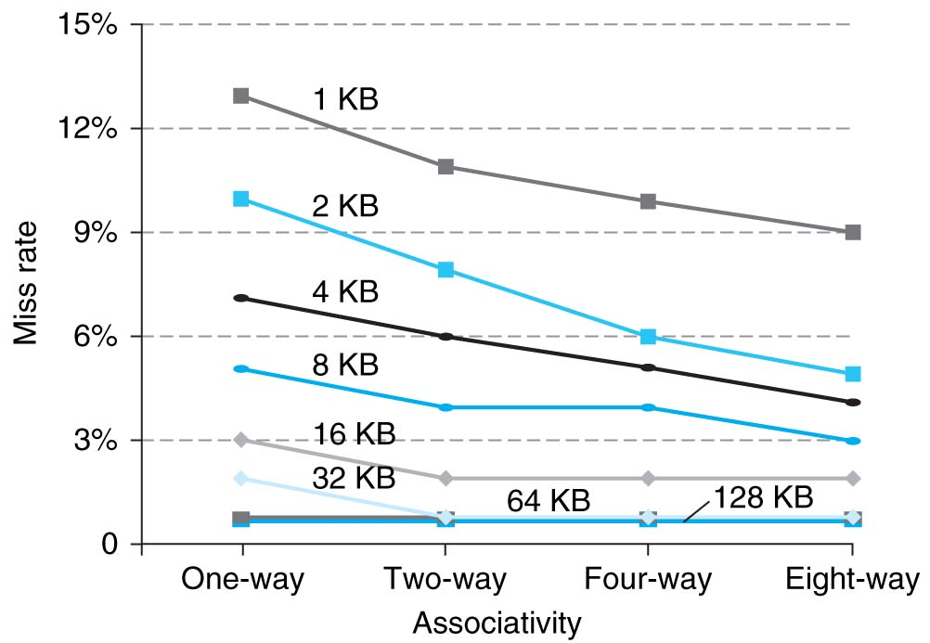
Benefits of Set-Associative Caches
Choice of DM $ versus SA $ depends on the cost of a miss versus the cost of implementation
Largest gains are in going from direct mapped to 2-way (20%+ reduction in miss rate)

Slide 45
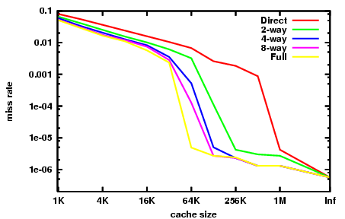
Miss Rate vs. Cache Size on the Integer Portion of SPECCPU2000

